Slide 1
3. Data Exploration

Slide 2
Objectives of Data Exploration
Understanding data
Data preparation
Data mining tasks
Interpreting data mining results

Slide 3
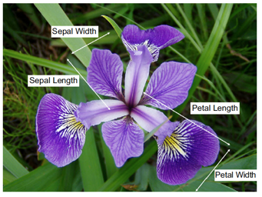
Data Sets
1http://commons.wikimedia.org/wiki/File:Iris_versicolor_3.jpg#mediaviewer/File:Iris_versicolor_3.jpg

Slide 4
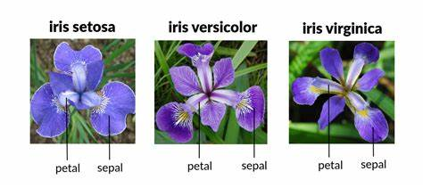

Slide 5
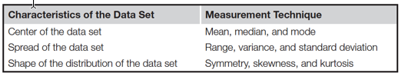
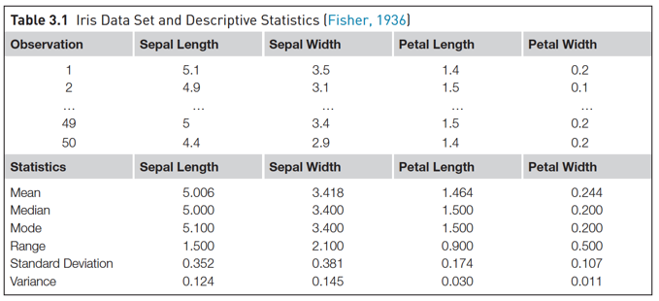
Descriptive Statistics - Univariate

Slide 6
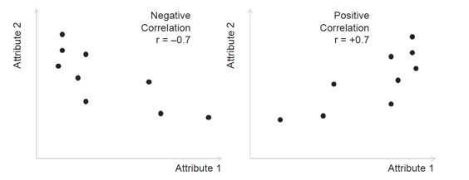
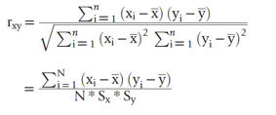
Descriptive Statistics - Multivariate
Central datapoint
Correlation

Slide 7
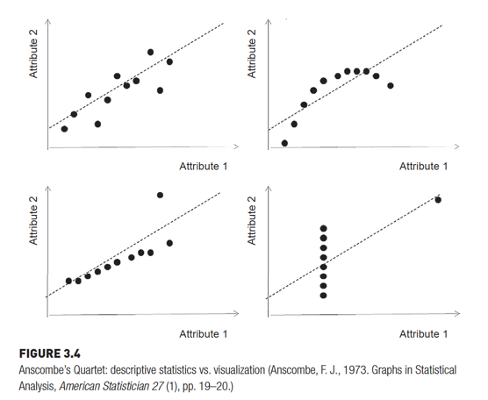
Descriptive Statistics - Multivariate

Slide 8
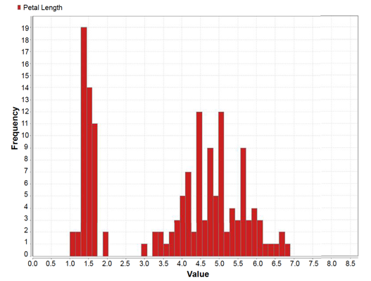
Data Visualization
Histogram

Slide 9
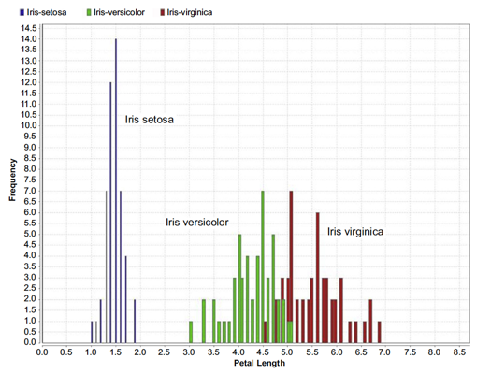
Data Visualization
Class stratified Histogram

Slide 10
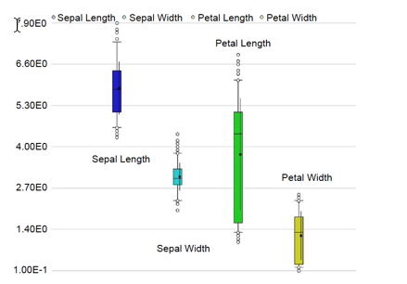
Data Visualization
Quantile plot

Slide 11
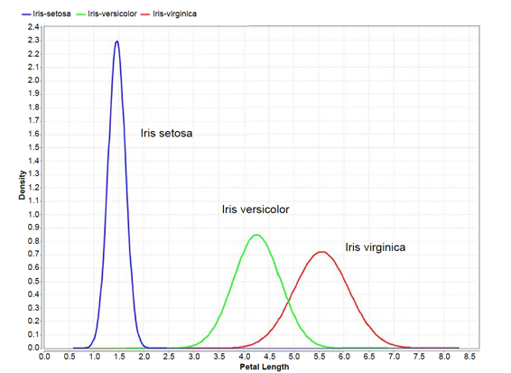
Data Visualization
Distribution plot

Slide 12
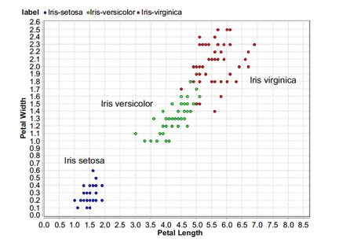
Data Visualization
Scatter plot

Slide 13
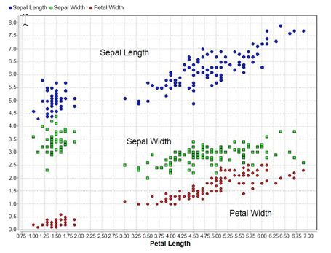
Data Visualization
Scatter mutiple

Slide 14
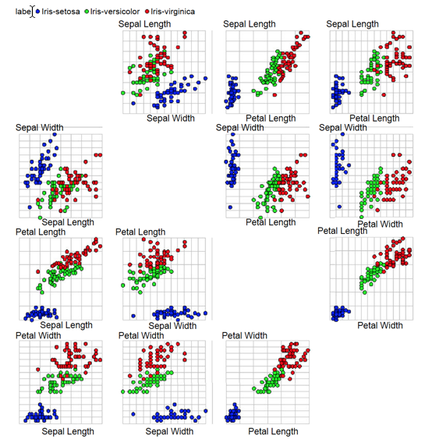
Data Visualization
Multiple Scatter matrix

Slide 15
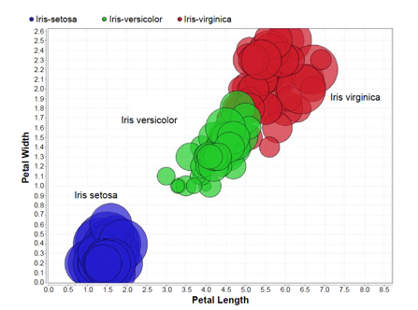
Data Visualization
Bubble plot

Slide 16
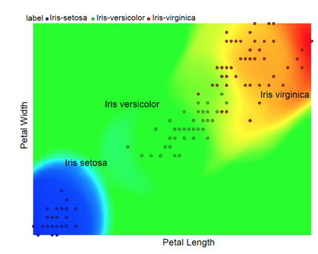
Data Visualization
Density chart

Slide 17
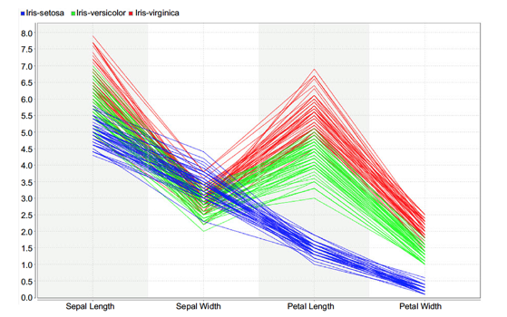
Data Visualization
Parallel chart

Slide 18
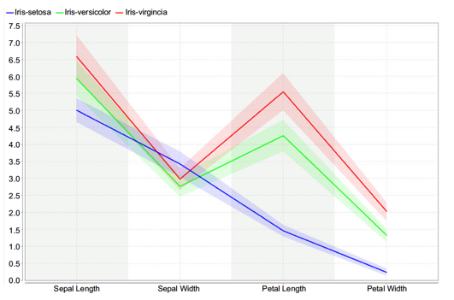
Data Visualization
Deviation chart

Slide 19
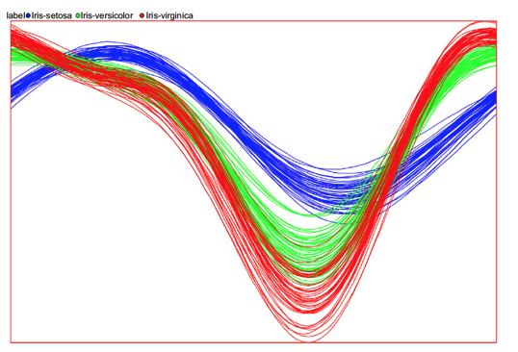
Data Visualization
Andrews curves

Slide 20
Roadmap for data exploration
1. Organize the data set
2. Find the central point for each attribute:
3. Understand the spread of the attributes:
4. Visualize the distribution of each attributes:
5. Pivot the data:
6. Watch out for outliers:
7. Understanding the relationship between attributes:
8. Visualize the relationship between attributes:
9. Visualization high dimensional data sets:
Kotu, V., & Deshpande, B. (2014). Predictive analytics and data mining: concepts and practice with rapidminer. Morgan Kaufmann.

Slide 21
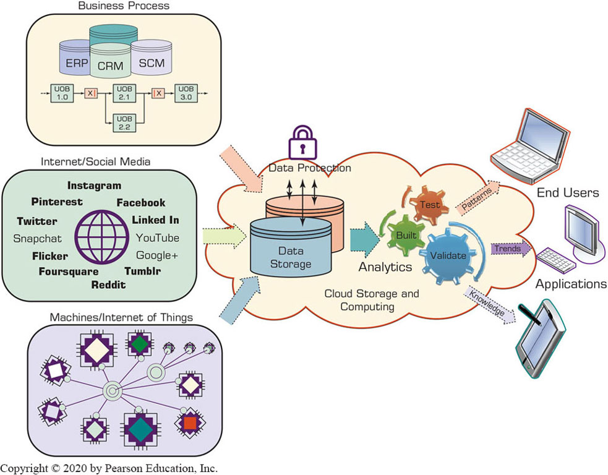
The Nature of Data

Slide 22
Metrics for Analytics ready Data
Data source reliability
Data content accuracy
Data accessibility
Data security and data privacy
Data richness
Data consistency
Data currency/data timeliness
Data granularity
Data validity and data relevancy

Slide 23
A Simple Taxonomy of Data (1 of 2)
Data (datum—singular form of data): facts
Structured data
Targeted for computers to process
Numeric versus nominal
Unstructured/textual data
Targeted for humans to process/digest
Semi-structured data?
X M L, H T M L, Log files, etc.
Data taxonomy…

Slide 24
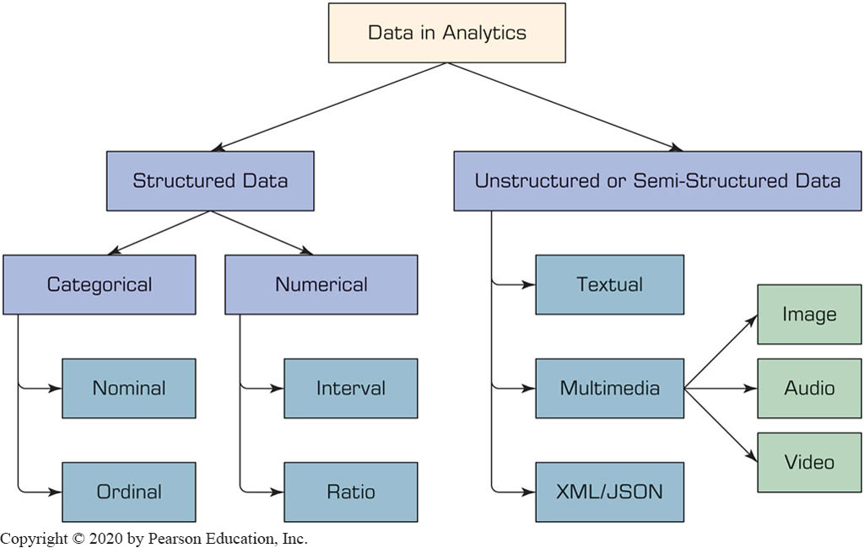
A Simple Taxonomy of Data (2 of 2)

Slide 25
The Art and Science of Data Preprocessing (1 of 2)
The real-world data is dirty, misaligned, overly complex, and inaccurate
Not ready for analytics!
Readying the data for analytics is needed
Data preprocessing
Data consolidation
Data cleaning
Data transformation
Data reduction
Art – it develops and improves with experience

Slide 26
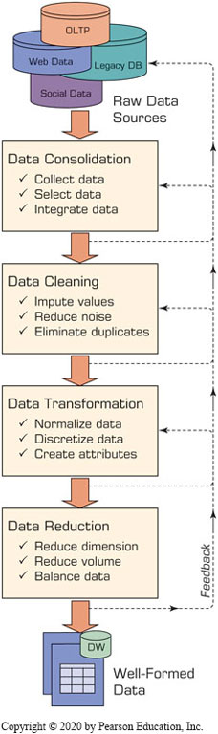
The Art and Science of Data Preprocessing (2 of 2)
Data reduction
Variables
Dimensional reduction
Variable selection
2. Cases/samples
Sampling
Balancing / stratification

Slide 27
Data Preprocessing Tasks and Methods
Table 3.1 A Summary of Data Preprocessing Tasks and Potential Methods.
Main Task | Subtasks | Popular Methods
Data consolidation | Access and collect the data Select and filter the data Integrate and unify the data | SQL queries, software agents, Web services. Domain expertise, SQL queries, statistical tests. SQL queries, domain expertise, ontology-driven data mapping.
Data cleaning | Handle missing values in the data | Fill in missing values (imputations) with most appropriate values (mean, median, min/max, mode, etc.); recode the missing values with a constant such as “ML”; remove the record of the missing value; do nothing.
Blank | Identify and reduce noise in the data | Identify the outliers in data with simple statistical techniques (such as averages and standard deviations) or with cluster analysis; once identified, either remove the outliers or smooth them by using binning, regression, or simple averages.
Blank | Find and eliminate erroneous data | Identify the erroneous values in data (other than outliers), such as odd values, inconsistent class labels, odd distributions; once identified, use domain expertise to correct the values or remove the records holding the erroneous values.
Data transformation | Normalize the data | Reduce the range of values in each numerically valued variable to a standard range (e.g., 0 to 1 or −1 to +1) by using a variety of normalization or scaling techniques.
Blank | Discretize or aggregate the data | If needed, convert the numeric variables into discrete representations using range- or frequency-based binning techniques; for categorical variables, reduce the number of values by applying proper concept hierarchies.
Blank | Construct new attributes | Derive new and more informative variables from the existing ones using a wide range of mathematical functions (as simple as addition and multiplication or as complex as a hybrid combination of log transformations).
Data reduction | Reduce number of attributes | Use principal component analysis, independent component analysis, chi-square testing, correlation analysis, and decision tree induction.
Blank | Reduce number of records | Perform random sampling, stratified sampling, expert-knowledge-driven purposeful sampling.
Blank | Balance skewed data | Oversample the less represented or undersample the more represented classes.

Slide 28
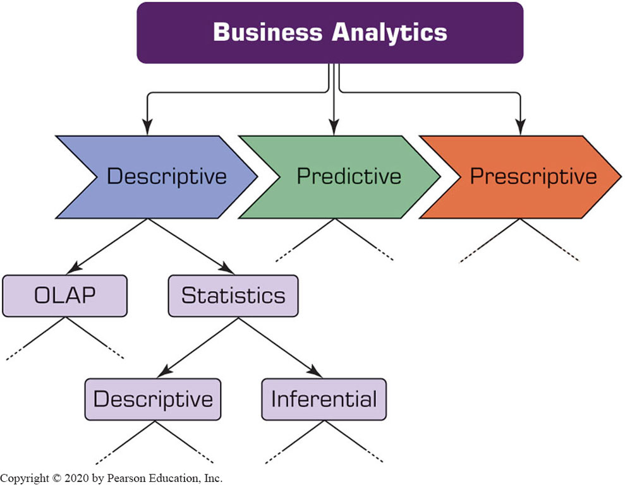


Statistical Modeling for Business Analytics (1 of 2)

Slide 29

Statistical Modeling for Business Analytics (2 of 2)
Statistics
A collection of mathematical techniques to characterize and interpret data
Descriptive Statistics
Describing the data (as it is)
Inferential statistics
Drawing inferences about the population based on a sample data
Descriptive statistics for descriptive analytics

Slide 30

Descriptive Statistics Measures of Centrality Tendency (1 of 2)
Arithmetic mean
Median
The number in the middle
Mode
The most frequent observation

Slide 31
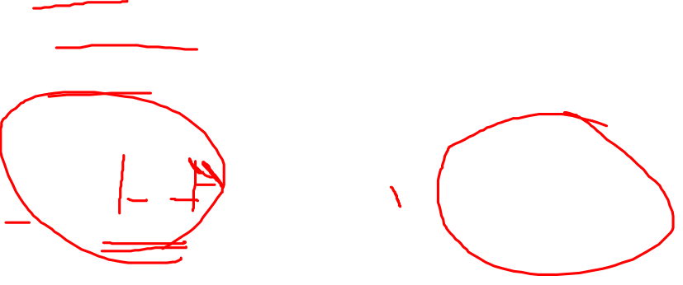
Descriptive Statistics Measures of Dispersion (1 of 2)
Dispersion
Degree of variation in a given variable
Range
Max - Min
Variance Standard Deviation
Mean Absolute Deviation (M A D)
Average absolute deviation from the mean

Slide 32
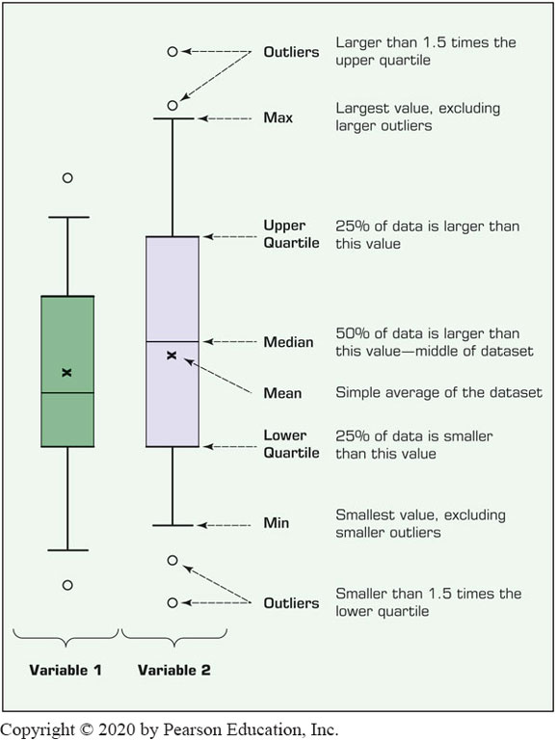
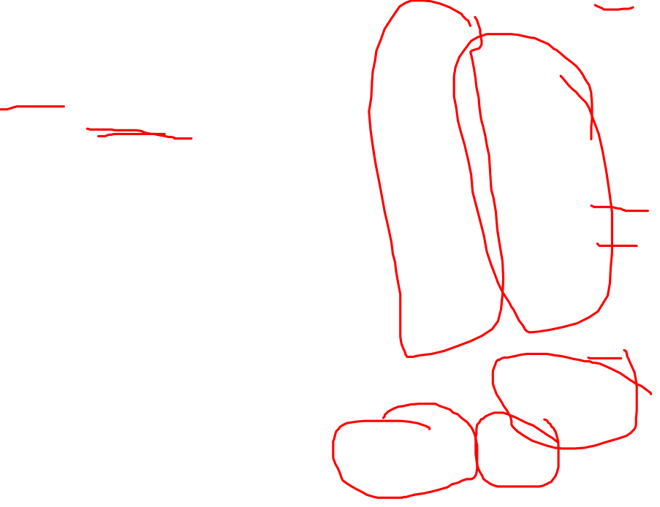
Descriptive Statistics Measures of Dispersion (2 of 2)
Quartiles
Box-and-Whiskers Plot
a.k.a. box-plot
Versatile / informative

Slide 33
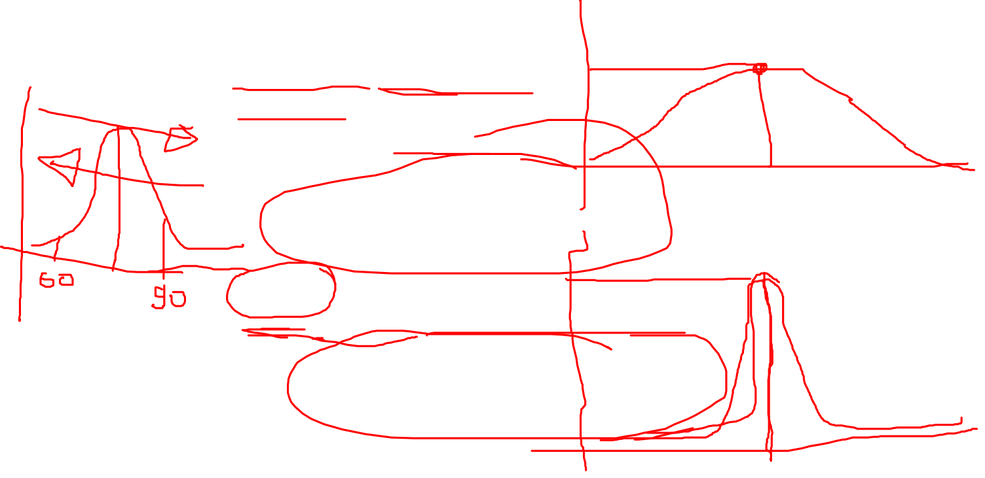
Descriptive Statistics Measures of Centrality Tendency (2 of 2)
Histogram - frequency chart
Skewness
Measure of asymmetry
Kurtosis
Peak/tall/skinny nature of the distribution

Slide 34
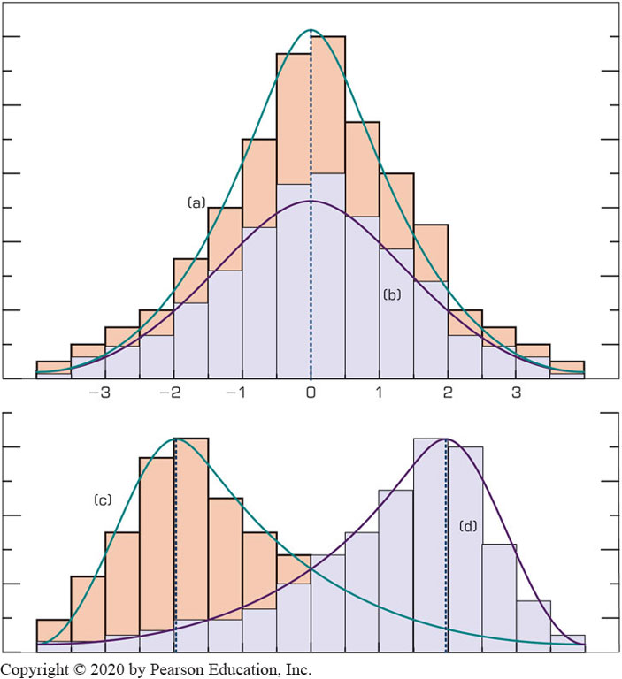
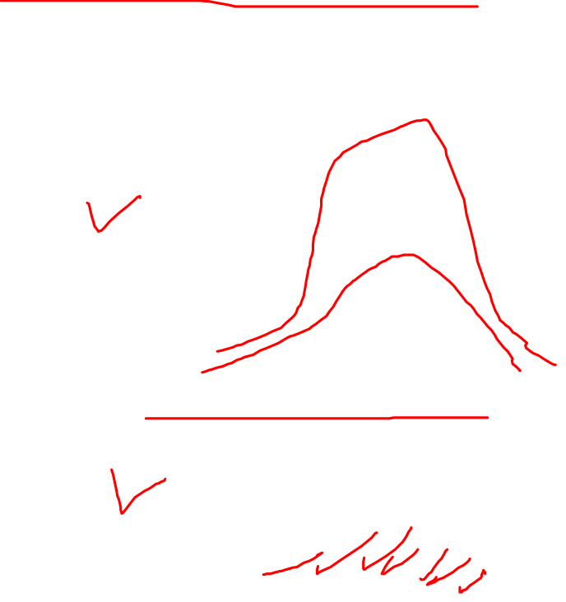
Relationship Between Dispersion and Shape Properties

Slide 35
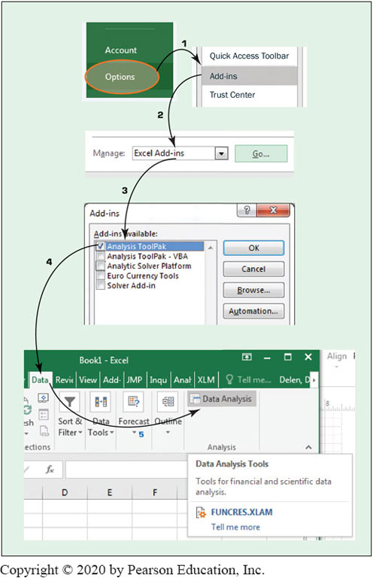
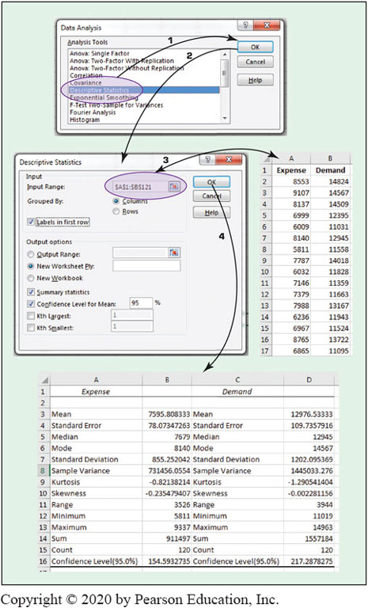

Technology Insights 3.1 – Descriptive Statistics in Excel

Slide 36
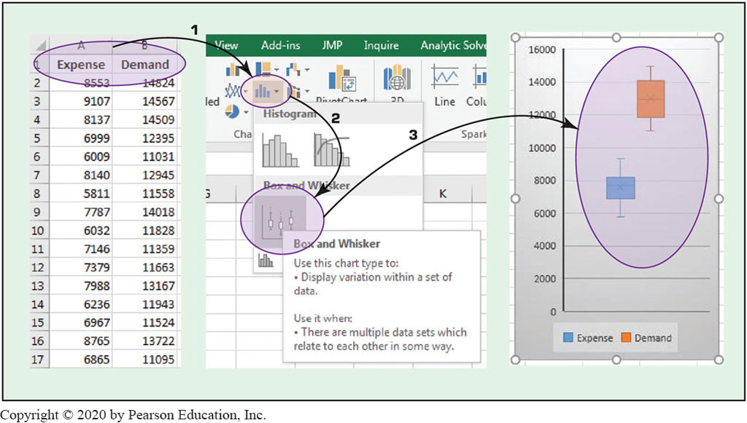

Technology Insights 3.1 – Descriptive Statistics in Excel Creating box-plot in Microsoft Excel

Slide 37
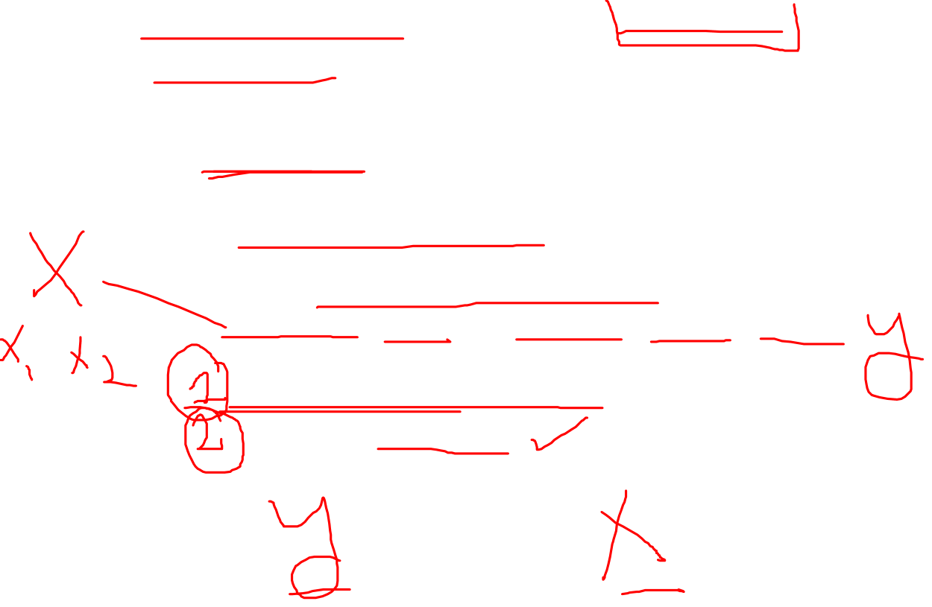
Regression Modeling for Inferential Statistics
Regression
A part of inferential statistics
The most widely known and used analytics technique in statistics
Used to characterize relationship between explanatory (input) and response (output) variable
It can be used for
Hypothesis testing (explanation)
Forecasting (prediction)

Slide 38
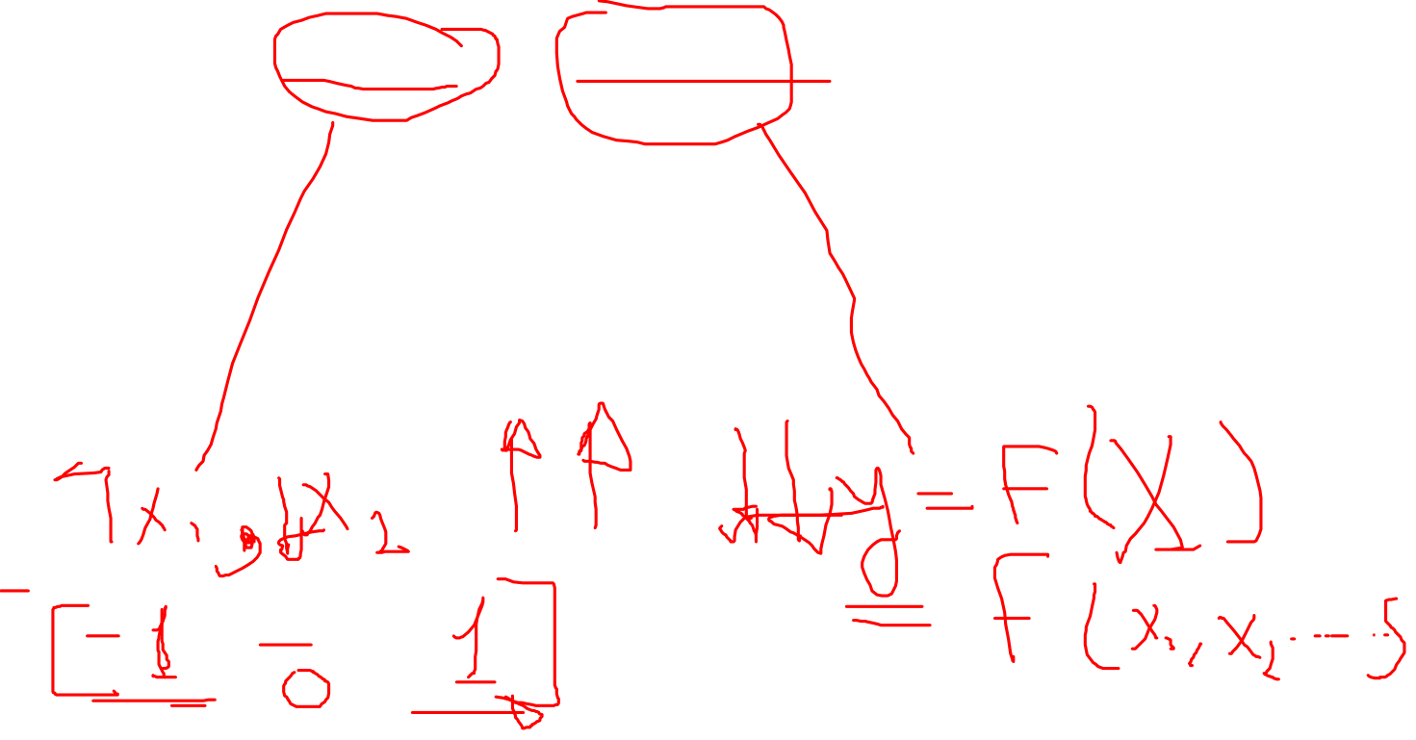
Regression Modeling (1 of 3)
Correlation versus Regression
What is the difference (or relationship)?
Simple Regression versus Multiple Regression
Base on number of input variables
How do we develop linear regression models?
Scatter plots (visualization—for simple regression)
Ordinary least squares method
A line that minimizes squared of the errors

Slide 39
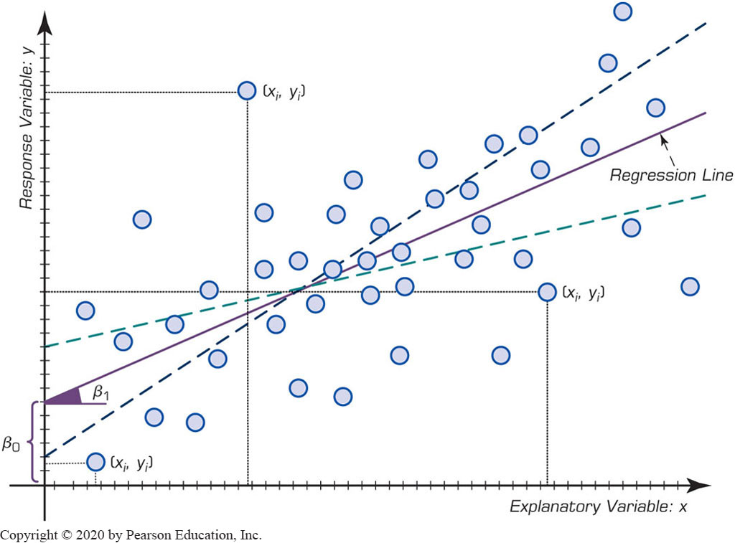
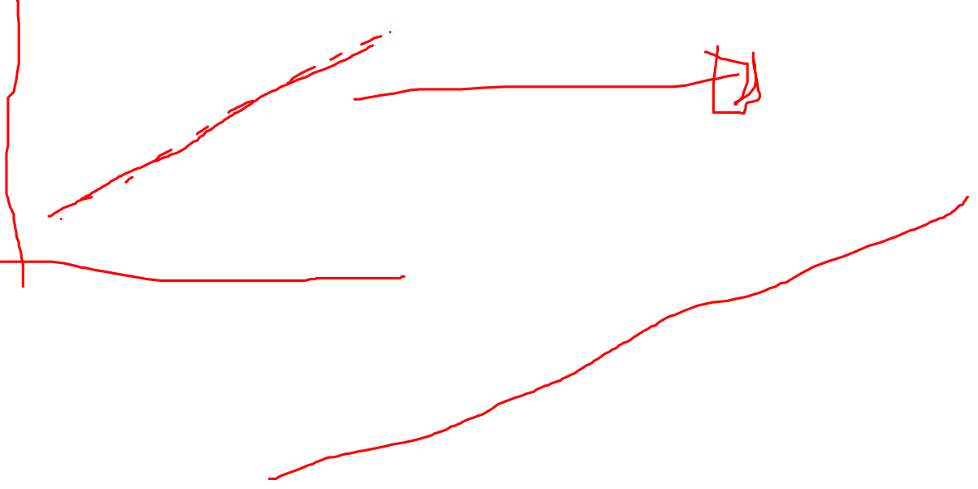
Regression Modeling (2 of 3)

Slide 40
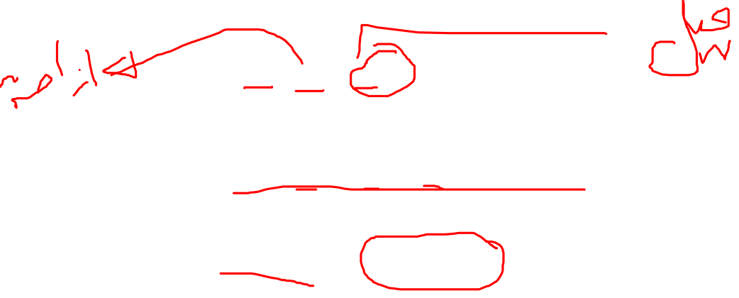
Regression Modeling (3 of 3)
x: input, y: output
Simple Linear Regression
Multiple Linear Regression
The meaning of Beta (β ) coefficients
Sign (+ or −) and magnitude

Slide 41
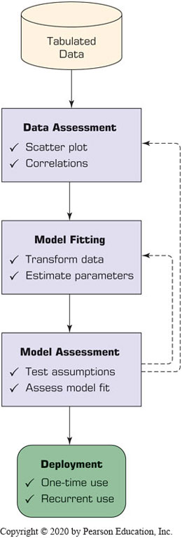
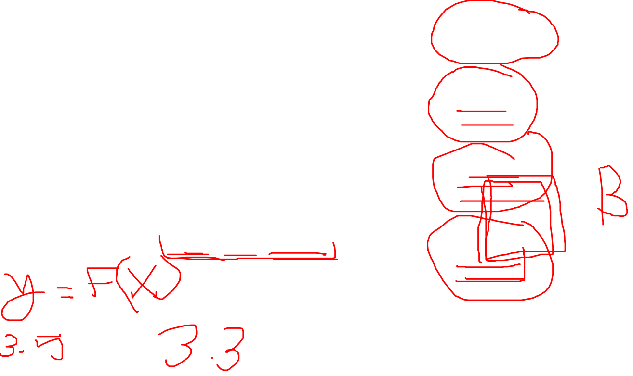
Process of Developing a Regression Model
How do we know if the model is good enough?
R² (R-Square)
p Values
Error measures (for prediction problems)
M S E, M A D, R M S E

Slide 42
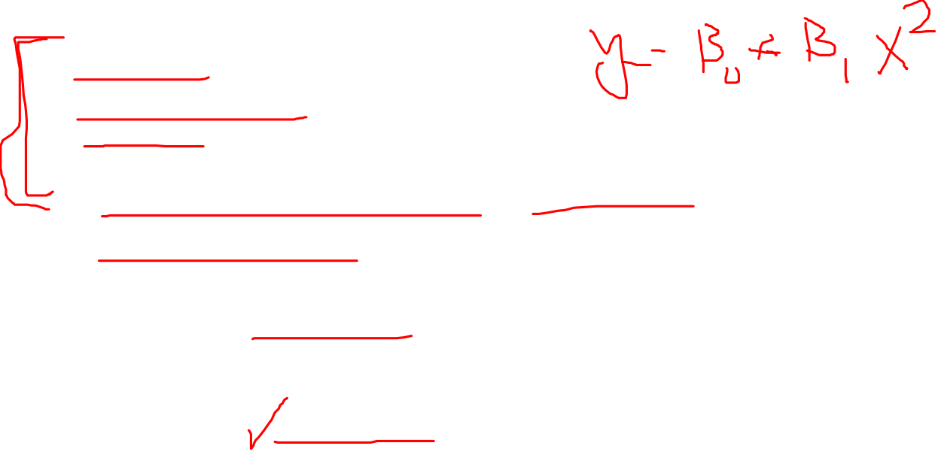
Regression Modeling Assumptions
Linearity
Independence
Normality (Normal Distribution)
Constant Variance
What happens if the assumptions do NOT hold?
What do we do then?

Slide 43
Business Reporting Definitions and Concepts
Report = Information → Decision
Report?
Any communication artifact prepared to convey specific information
A report can fulfill many functions
To ensure proper departmental functioning
To provide information
To provide the results of an analysis
To persuade others to act
To create an organizational memory…

Slide 44
What is a Business Report?
A written document that contains information regarding business matters.
Purpose: to improve managerial decisions
Source: data from inside and outside the organization (via the use of E T L)
Format: text + tables + graphs/charts
Distribution: in-print, email, portal/intranet
Data acquisition → Information generation → Decision making → Process management

Slide 45
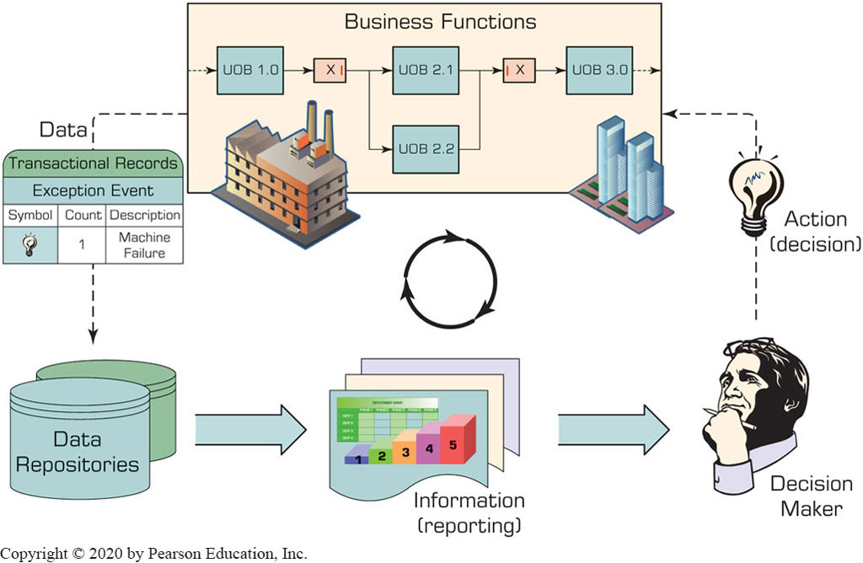
Business Reporting

Slide 46
Types of Business Reports
Metric Management Reports
Help manage business performance through metrics
(S L A s (service levels agreements) for externals;
K P I s for internals)
Dashboard-Type Reports
Graphical presentation of several performance indicators in a single page using dials/gauges
Balanced Scorecard–Type Reports
Include financial, customer, business process, and learning & growth indicators

Slide 47

Application Case 3.6
Macfarlan Smith Improves Operational Performance Insight with Tableau Online
Questions for Discussion:
What were the data and reporting related challenges Macfarlan Smith facing?
What was the solution and the obtained results and/or benefits?

Slide 48
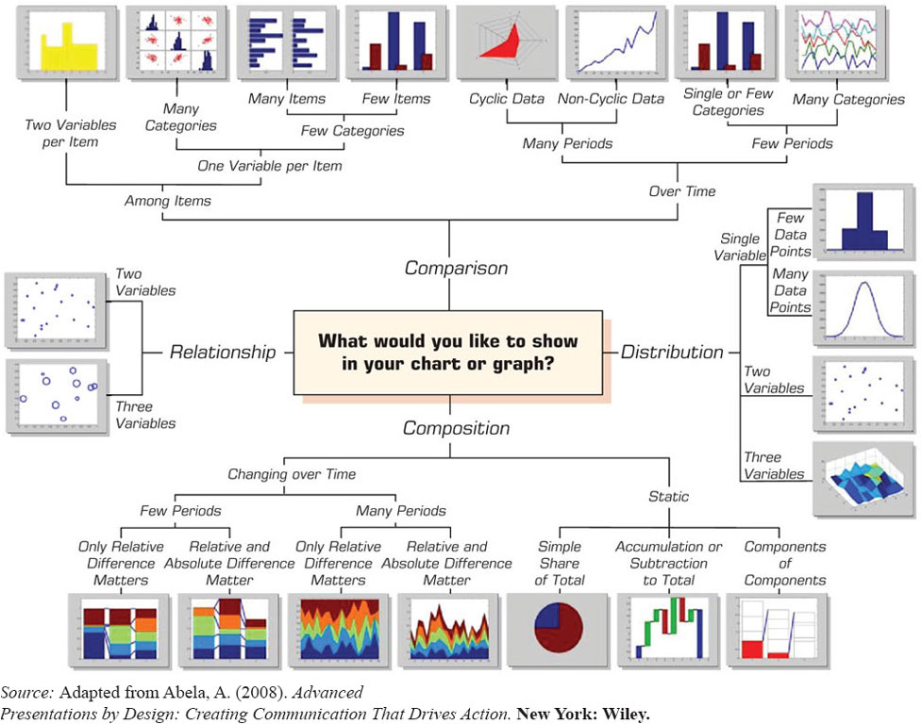
Which Chart or Graph Should You Use?
Figure 3.21 A Taxonomy of Charts and Graphs.
Source: Adapted from Abela, A. (2008). Advanced Presentations by Design: Creating Communication That Drives Action. New York: Wiley.

Slide 49
Data visualization
Trends
Line plot
Relationships
Distribution Plots
Scatter plots
Heat Map
Bar plots
Reg plot

Slide 50
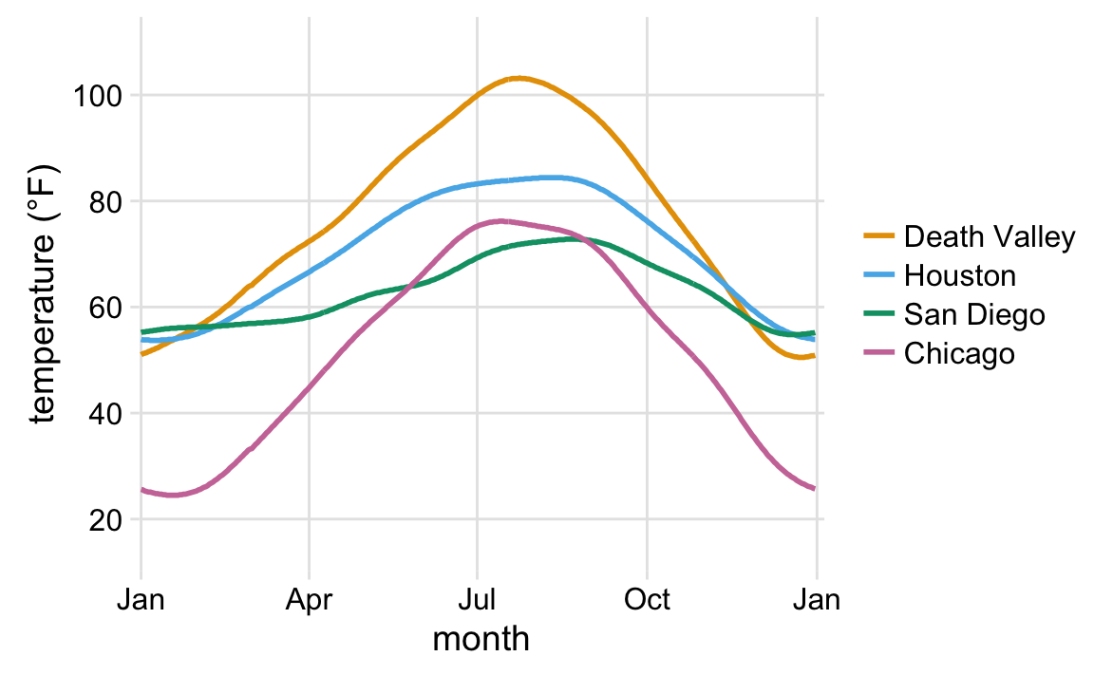
Line plot
Notes:
What do you see here? What’s the story and how do the aesthetics tell it?

Slide 51
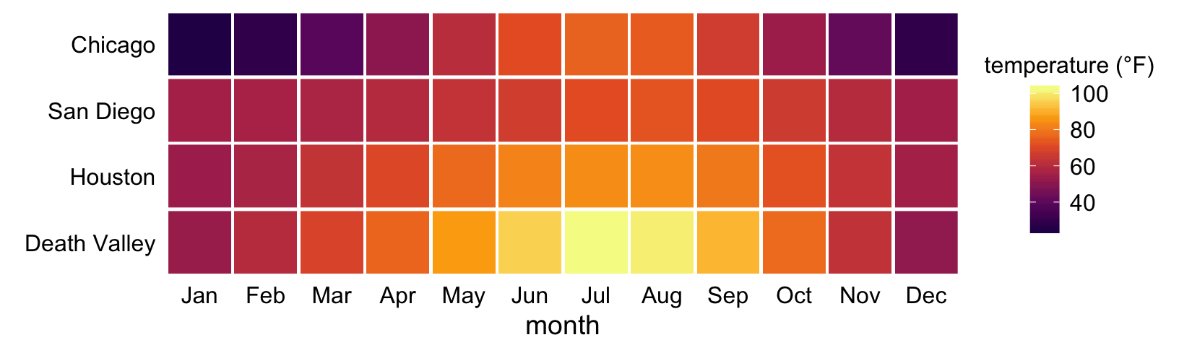
Heat Map
Notes:
This is the same data
What do you see here? What’s the story and how do the aesthetics tell it?

Slide 52
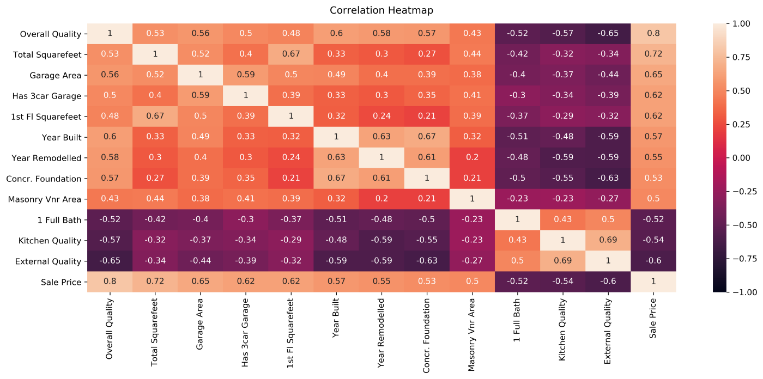

Slide 53
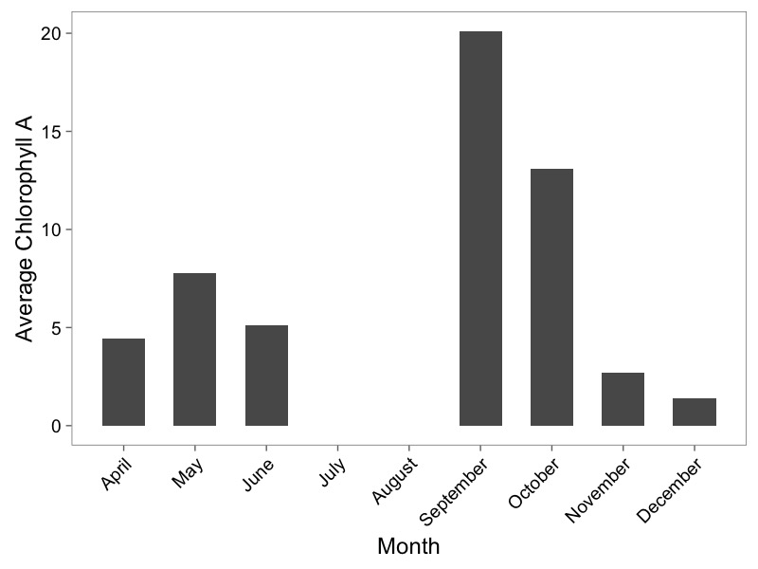
Barplots

Slide 54
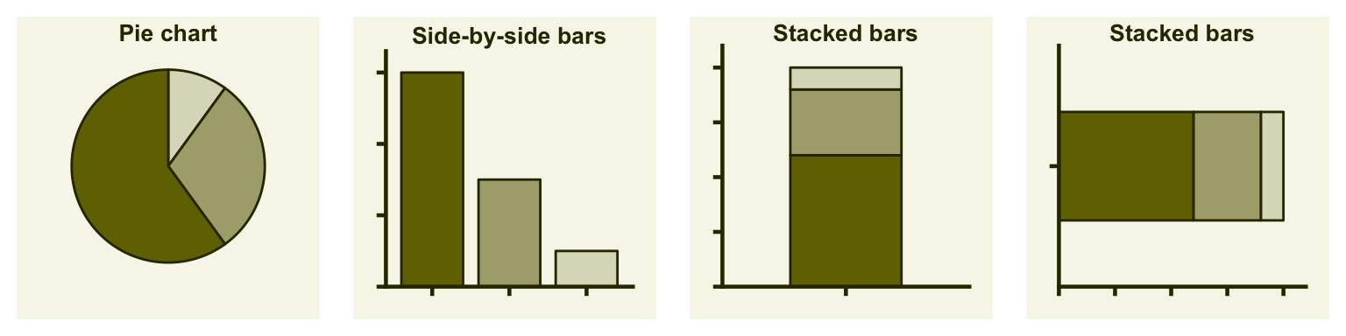
Types of Visualizations: Proportions
Notes:
Costs and benefits of each

Slide 55
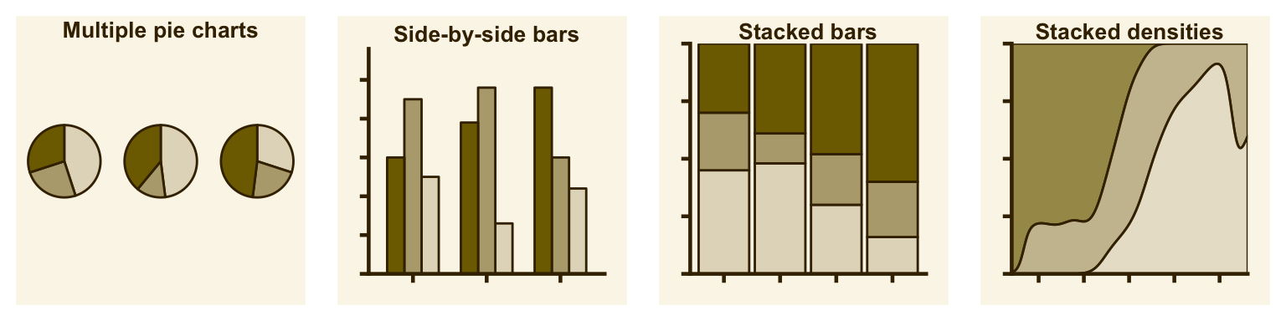
Types of Visualizations: Multiple Proportions
Wilke 2018
Notes:
Costs and benefits of each

Slide 56
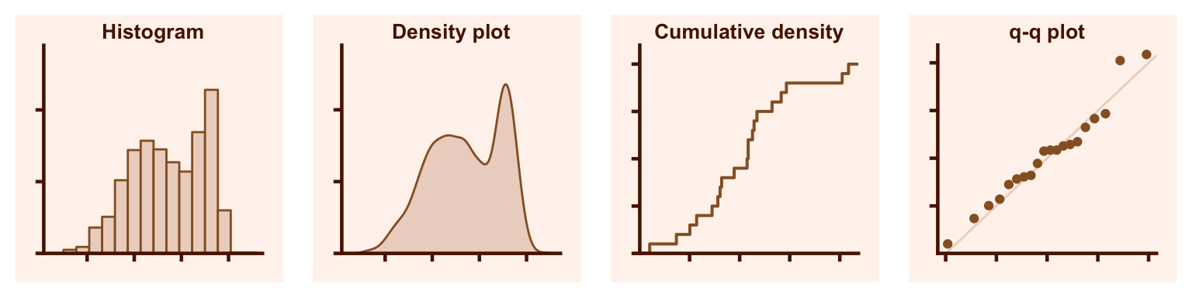
Types of Visualizations: Distributions
Wilke 2018

Slide 57
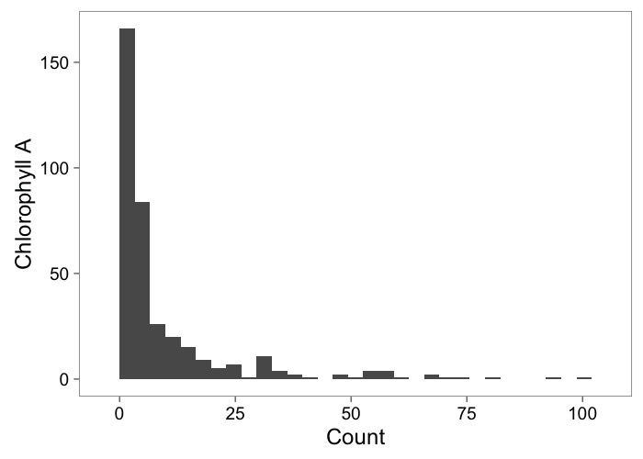
Histograms Show Frequency

Slide 58

Scatterplots Show Relationships

Slide 59
Dashboards

Slide 60
Power BI dashboards

Slide 61


Slide 62


Slide 63


Slide 64


Slide 65


Slide 66


Slide 67

Source: A Sample Executive Dashboard from Dundas Data Visualization, Inc., www.dundas.com, reprinted with permission.

